Slide 1


SERVICE
OUR CONTACT
ABOUT US
MEDICONNECT PROJECT
bY GROUP 4
START PRESENTATION

Slide 2

Introduction to
Mediconnect
Mediconnect is a website designed to connect patients and doctors in a simple and efficient way.
The main problem Mediconnect aims to solve is the difficulty patients face when trying to book medical appointments and access reliable health information.
The website is developed using PHP with the Laravel Framework, utilizing the Blade Template Engine for user interface development. The system combines HTML, CSS, and JavaScript to create an intuitive and user-friendly interface. Data is managed through a MySQL database.

Slide 3
Type of Users
The website has three main types of users: patients, doctors and admins, and each has different features.

Slide 4
Type of Users
Patients
Doctors
Admins
Make appointments with doctors
Read the latest medical news
Update their medical history
Create time slots
Able to accept patients appointments
Able to give patients quick diagnosis
Review and verify doctors profile
Manage patients profile
Manage and upload lastest medical news

Slide 5
1. General / Guest Users
Can access homepage
Quickly browse through a list of doctors
Read the latest medical news
Create new accounts
Login to personal accounts

Slide 6
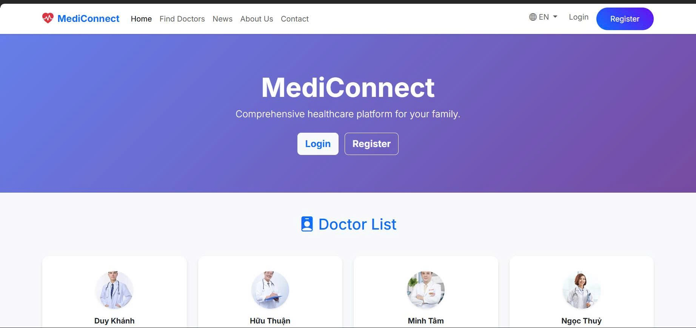
1. Homepage

Slide 7
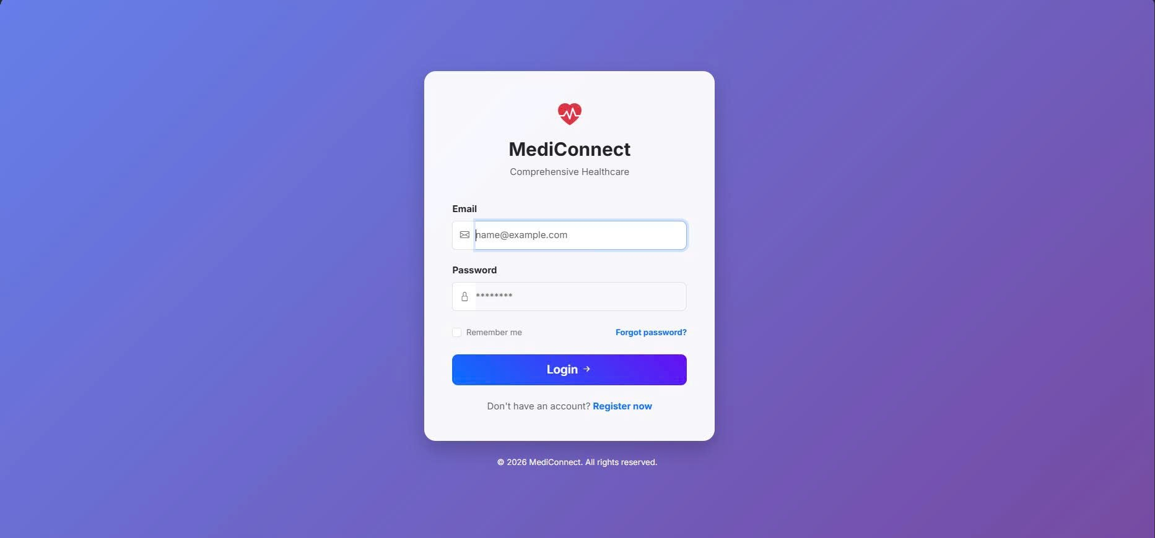
1.2. Login

Slide 8
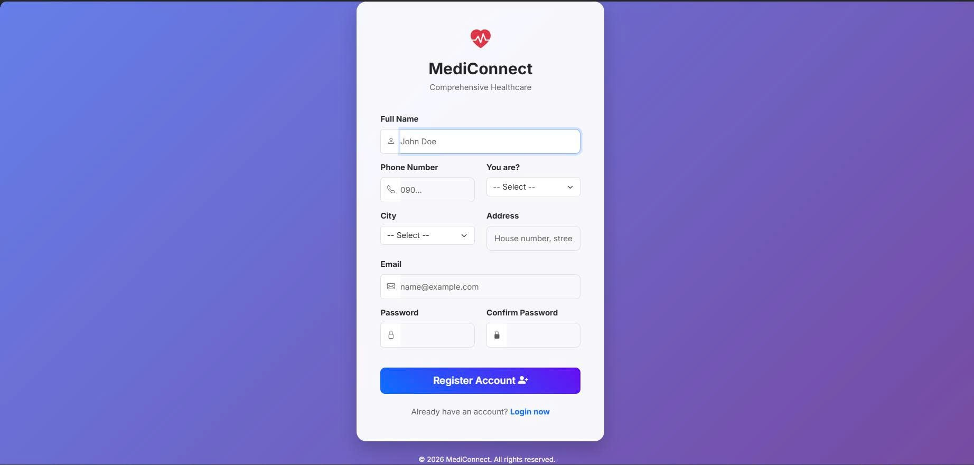
1.3. Register

Slide 9
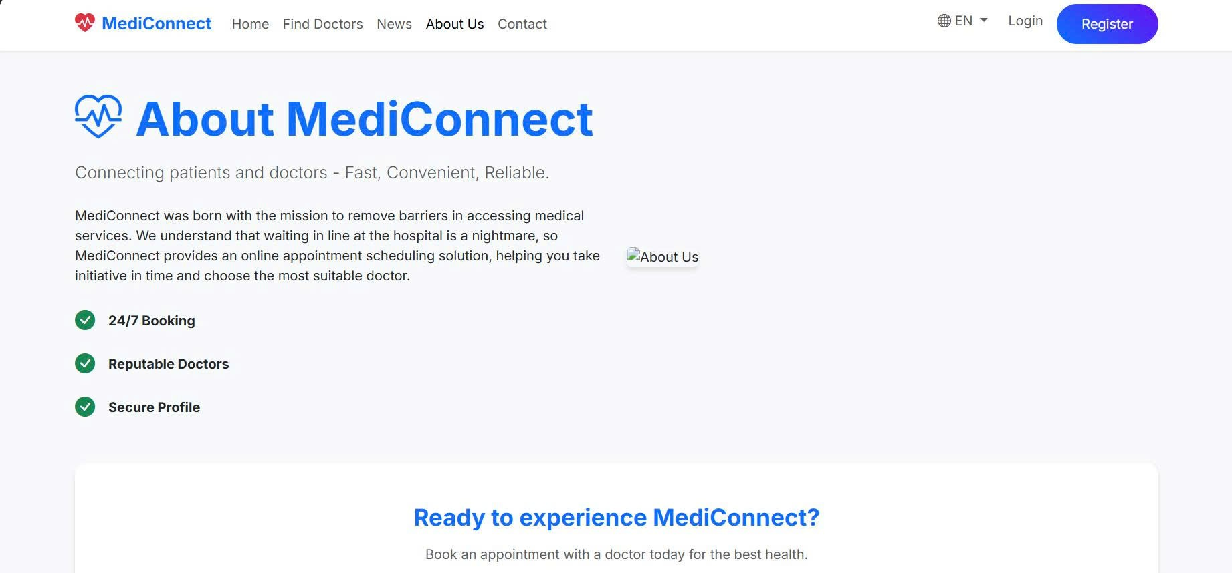
1.4. About Us

Slide 10
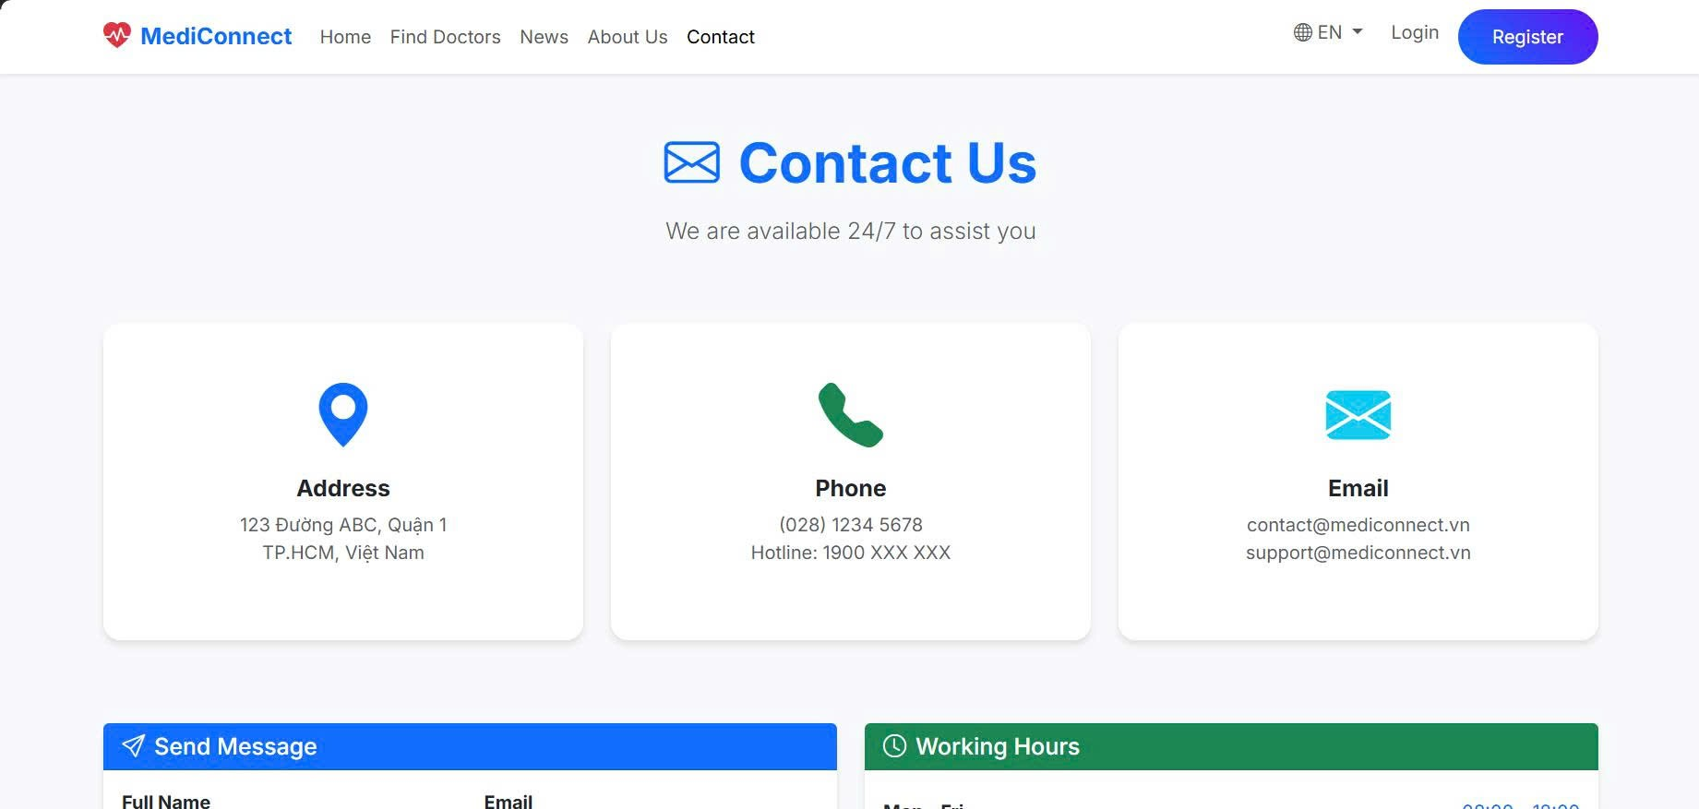
1.5. Contact Us

Slide 11
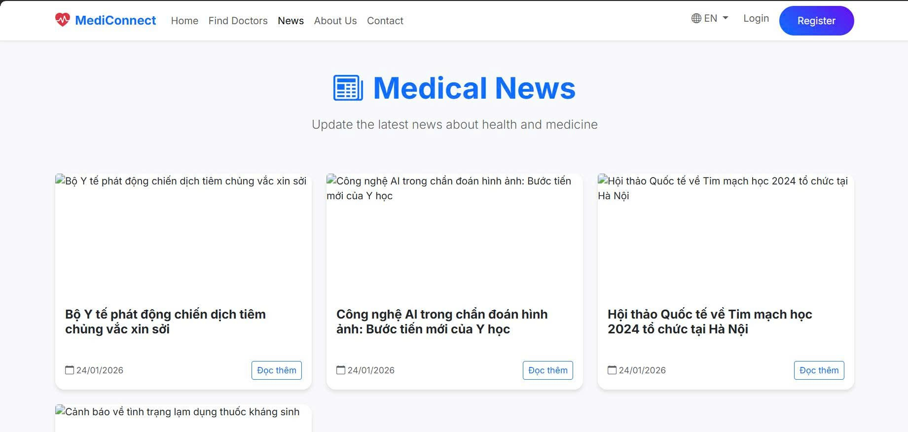
6. Medical News

Slide 12
2. Patients
Can access patient dashboard
Quickly browse their upcoming appointments and their appointment history
Find a specialized doctor and book appointment
View and edit personal profile
Quickly view the lastest medical news

Slide 13
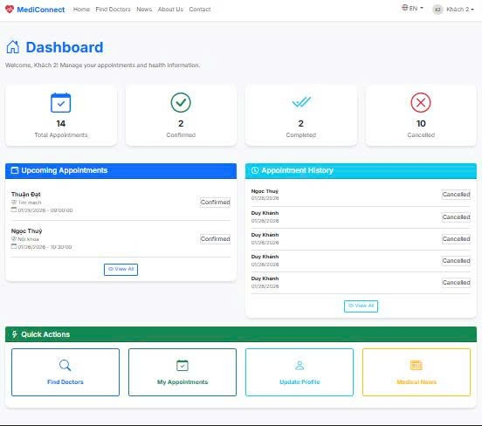
2.1. Patient Dashboard

Slide 14
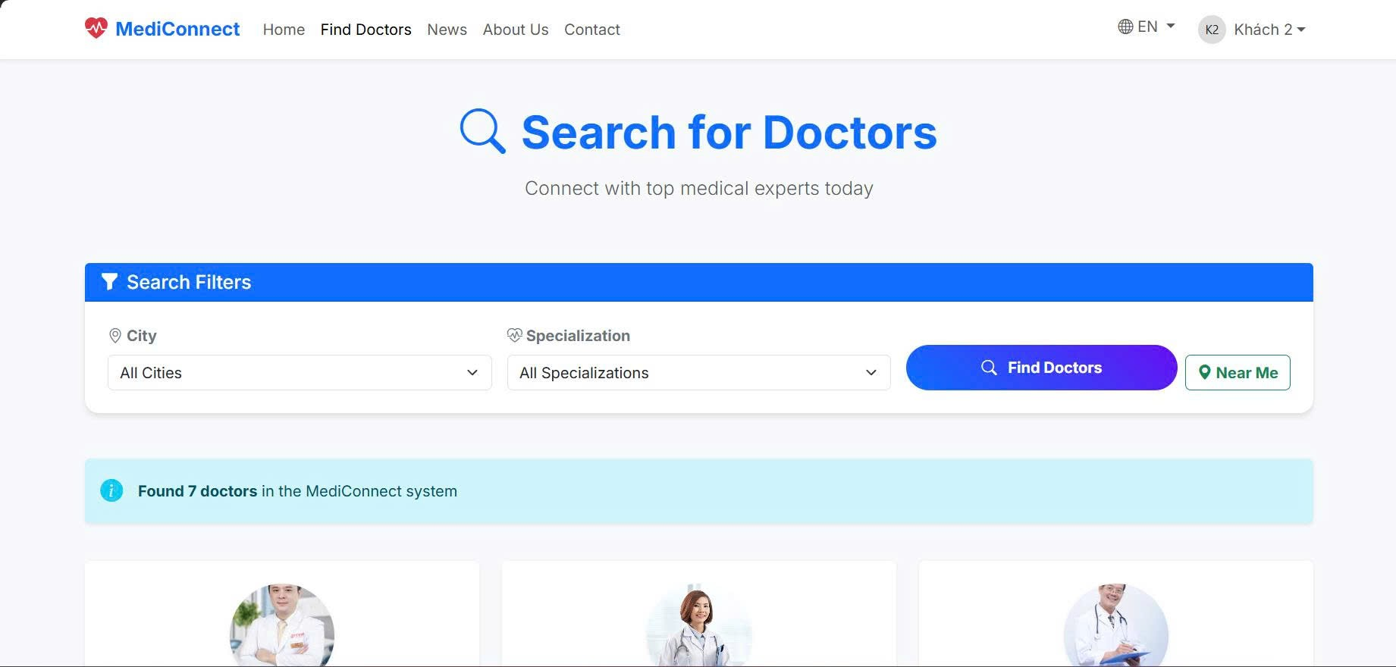
2.2. Doctor Search

Slide 15
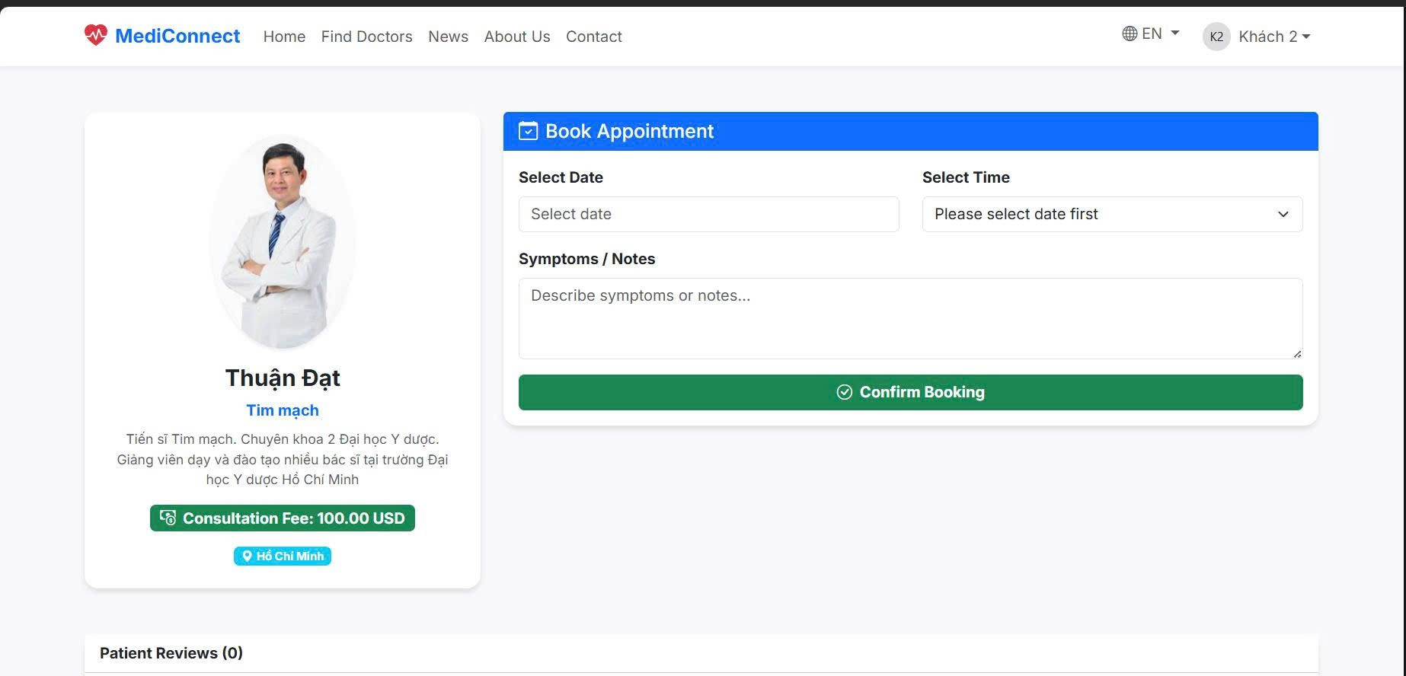
2.3. Appointment Booking

Slide 16
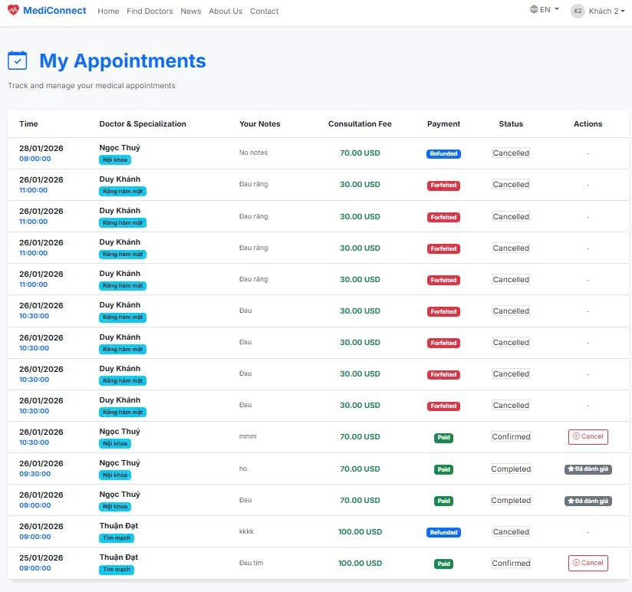
2.4. Patient Appointment

Slide 17
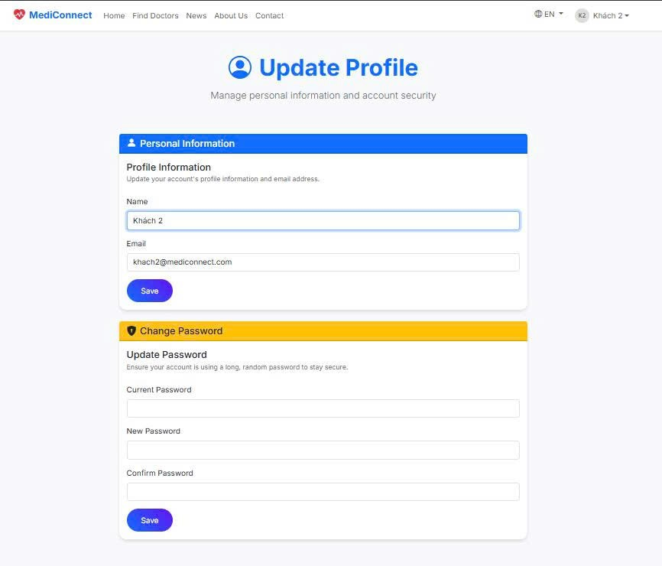
2.5. Patient Profile

Slide 18
3. Doctors
Can access doctor dashboard
Quickly view their upcoming appointments
Creating flexible timeslot for patients
View and edit their personal profile

Slide 19
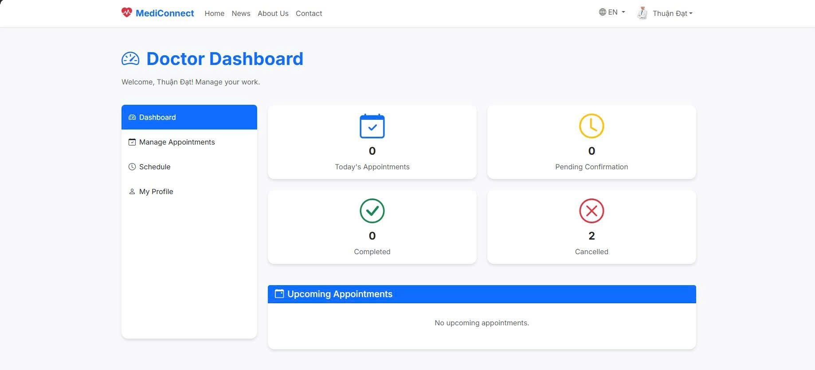
3.1. Doctor Dashboard

Slide 20
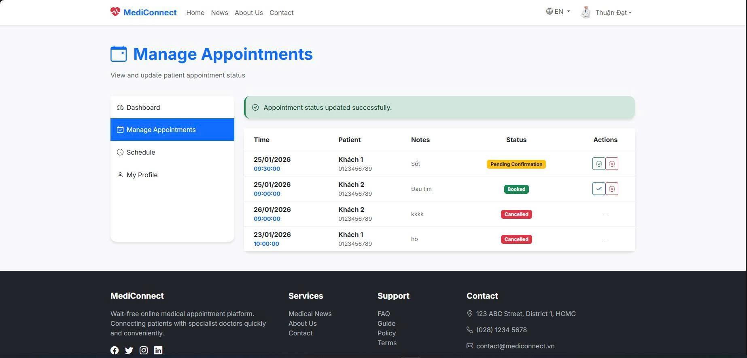
3.2. Doctor Appointment Management

Slide 21
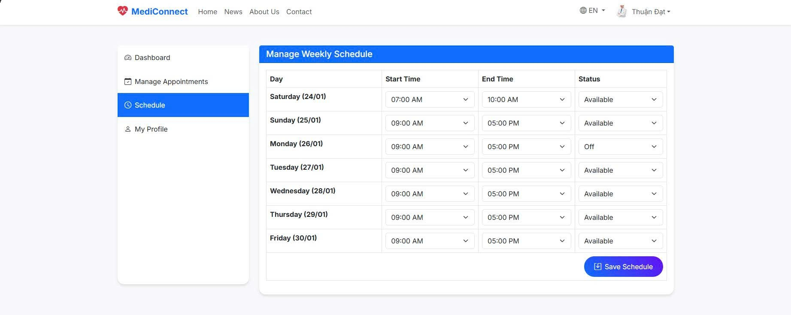
3.3. Doctor Schedule

Slide 22
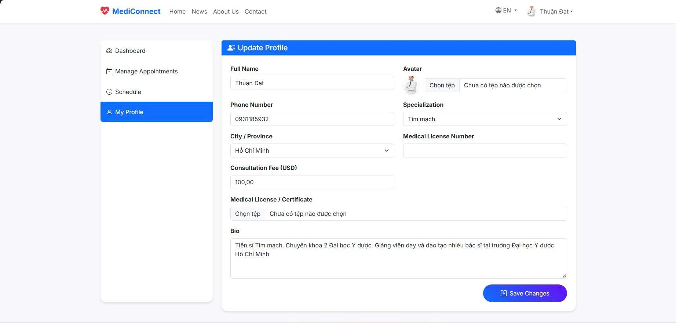
3.4. Doctor Profile

Slide 23
4. Admin
Can create new accounts and manage all patients and doctors accounts and view their personal profile
View and edit all appointments
Post new medical news
View patients feedback
Manage medical specialties and cities

Slide 24
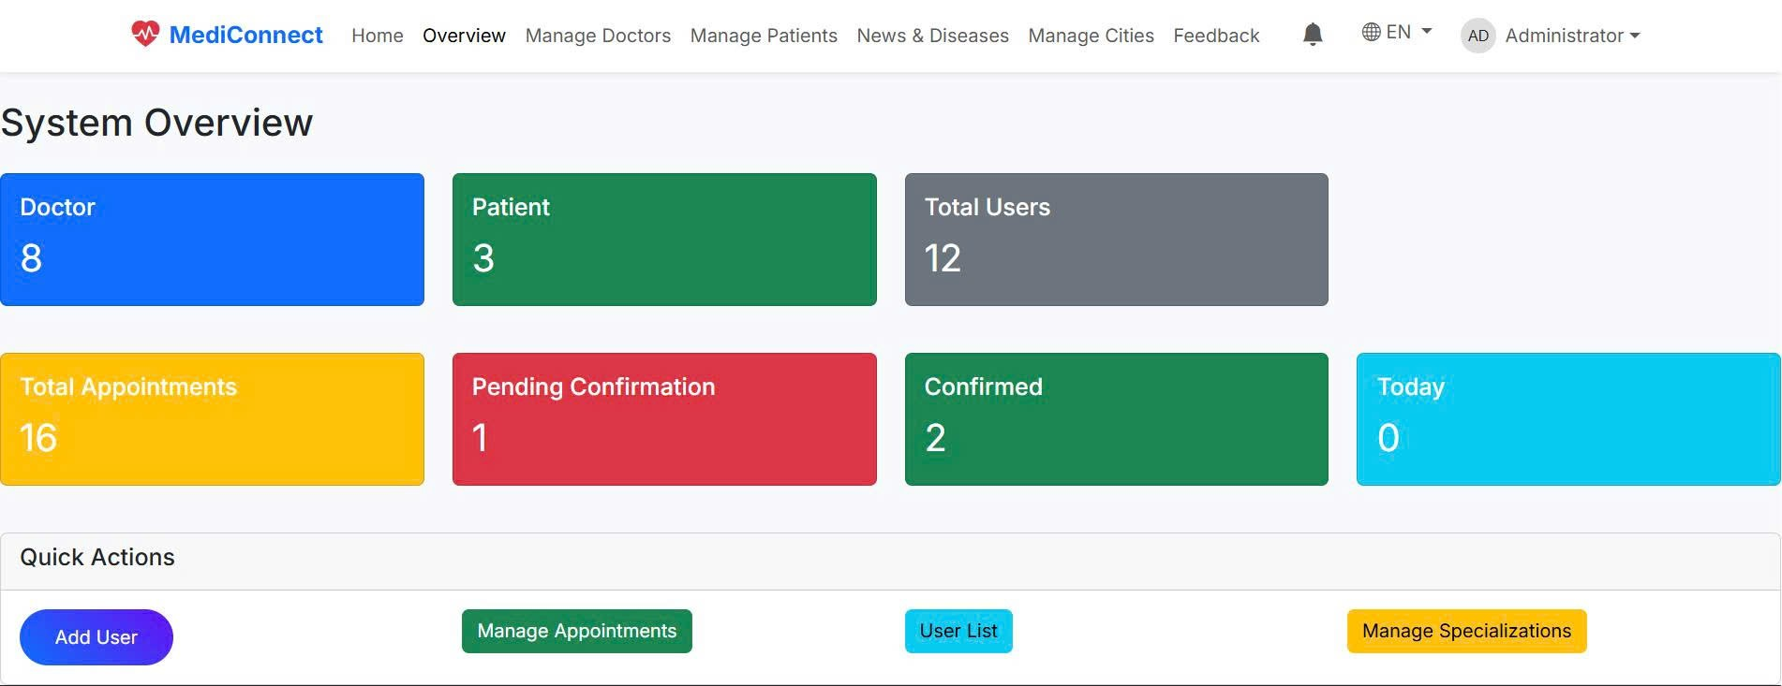
4.1. Admin Dashboard

Slide 25
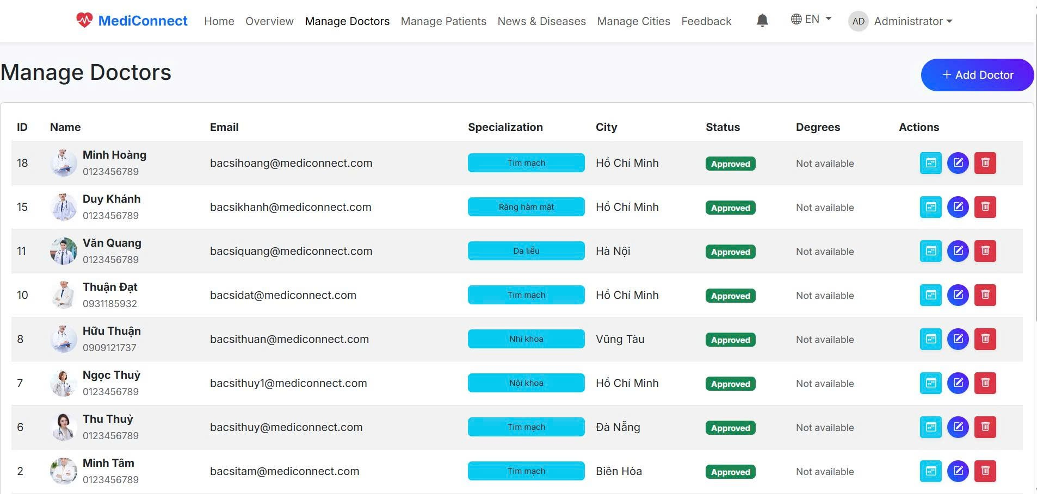
4.2. Doctor Management

Slide 26
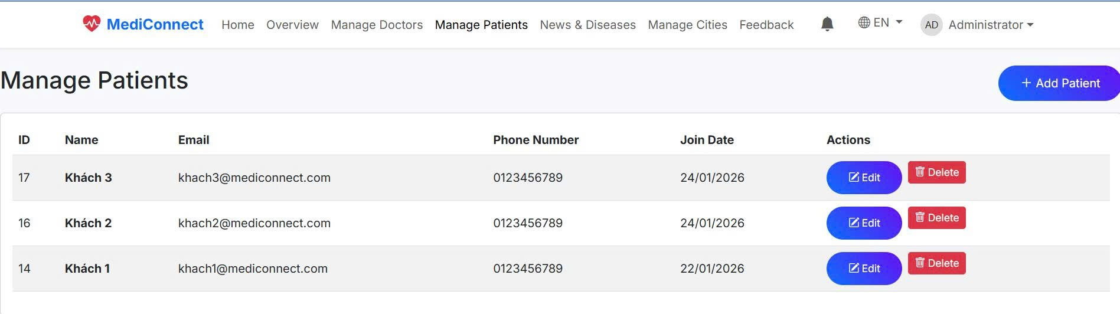
4.3. Patient Management

Slide 27
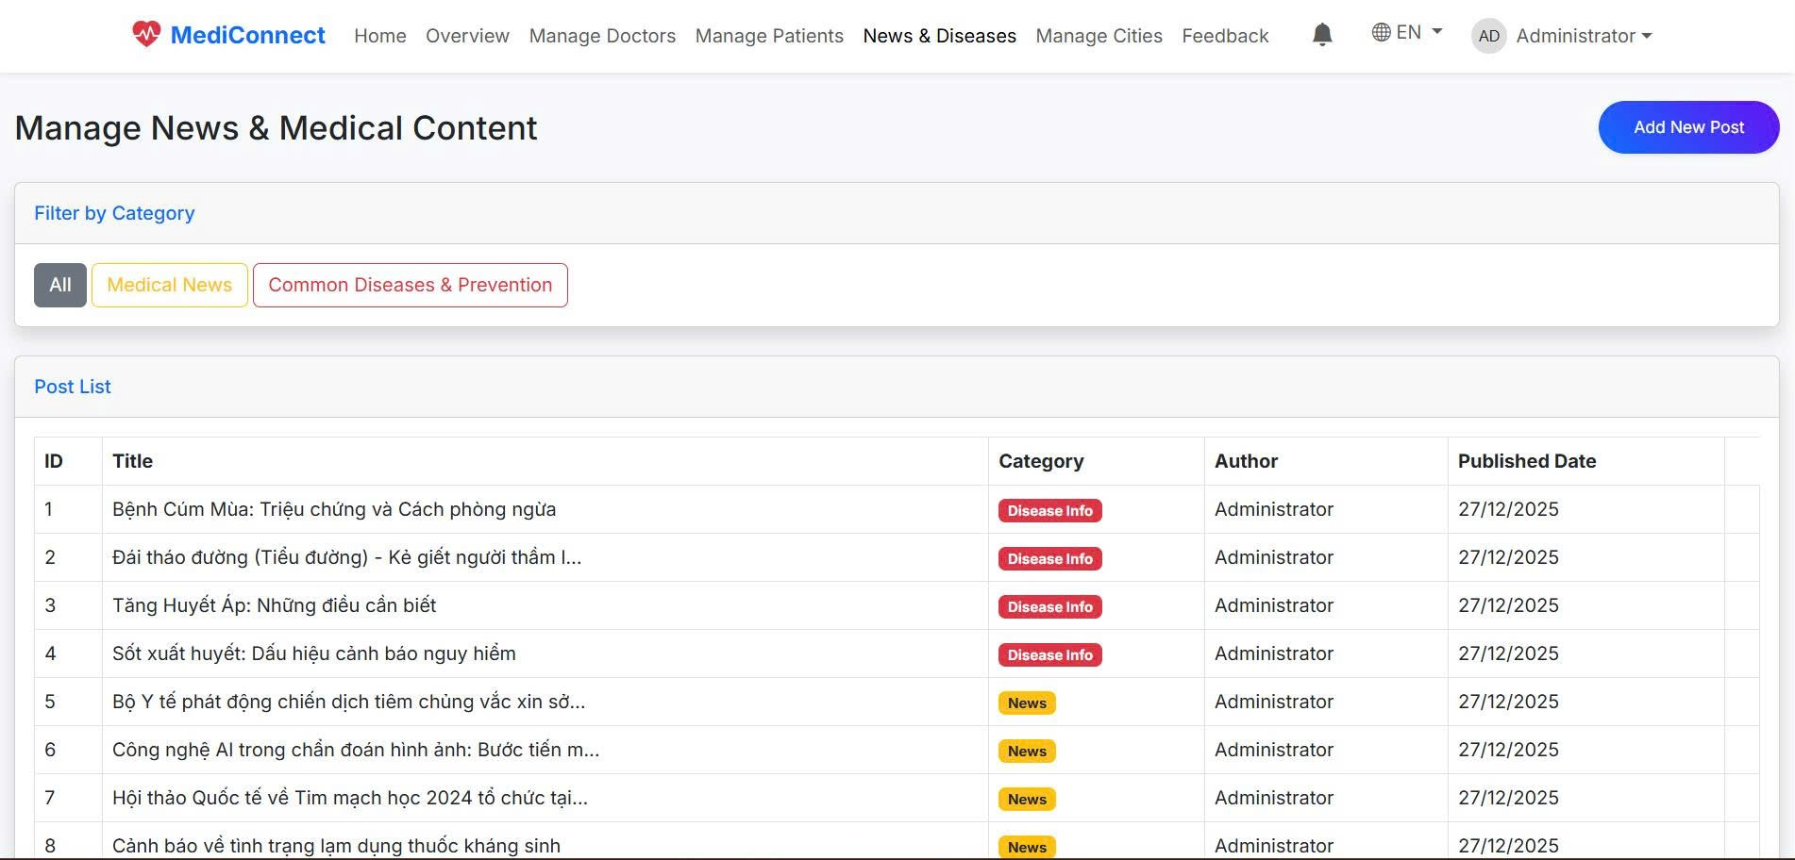
4.4. News Management

Slide 28
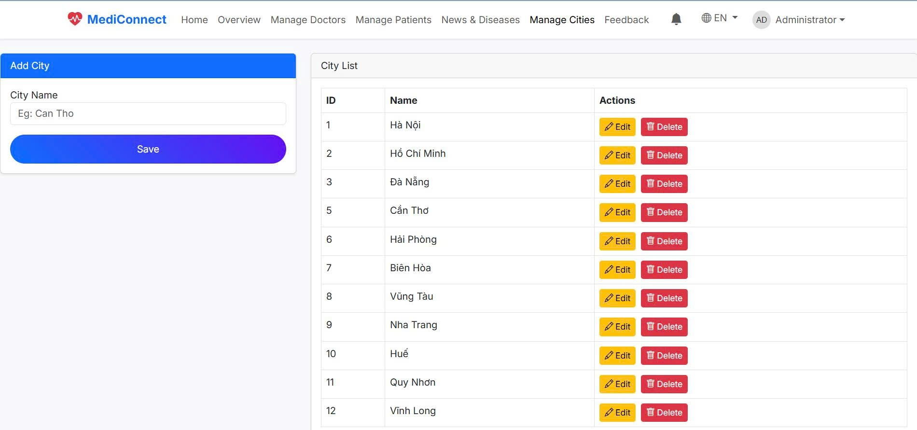
4.5. Location/Cities Management

Slide 29
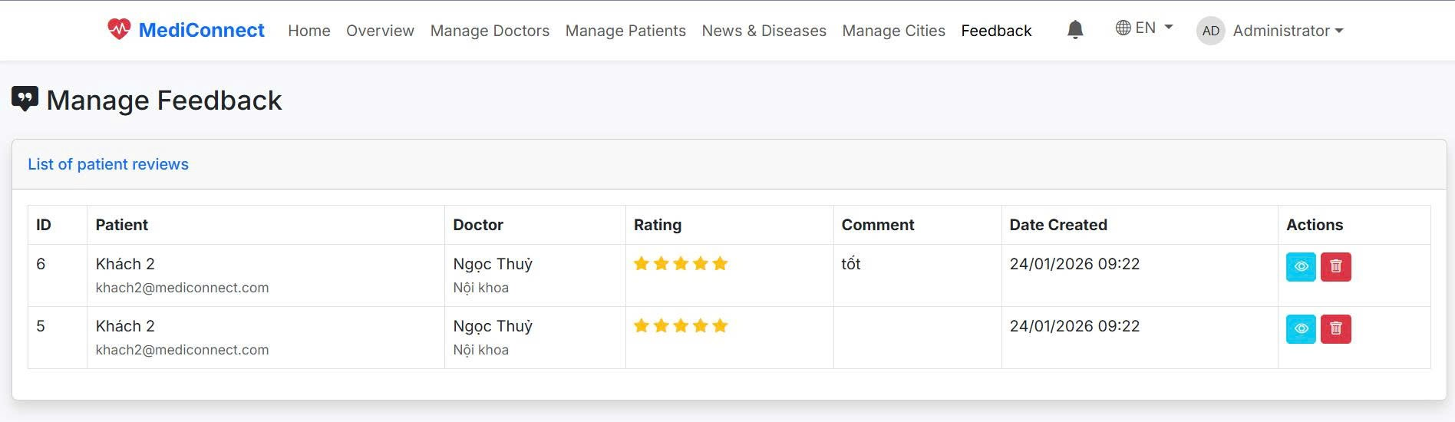
4.6. Feedback Management

Slide 30
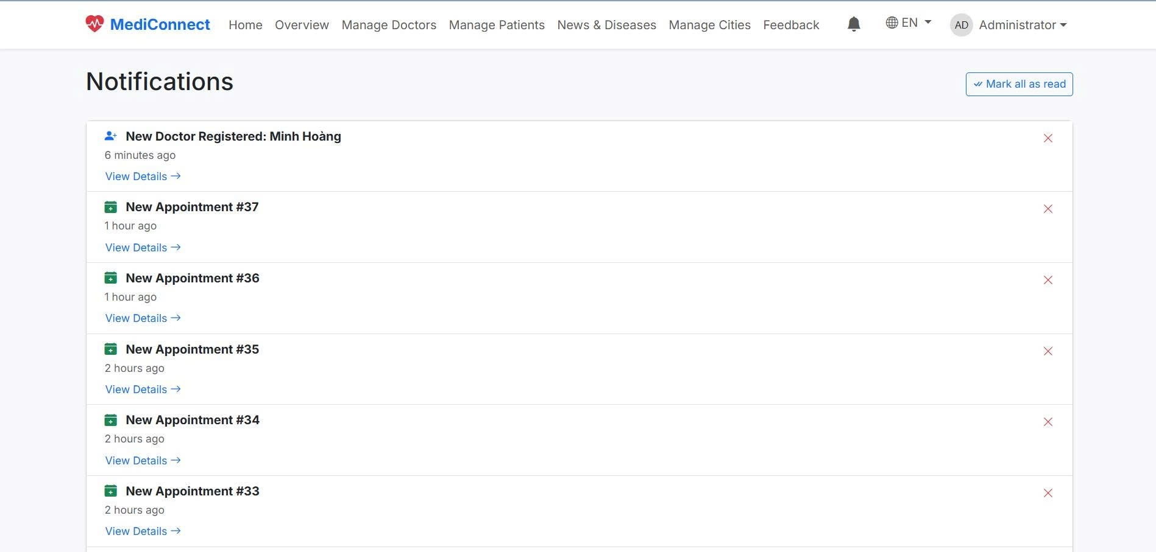
4.7.Notification

Slide 31
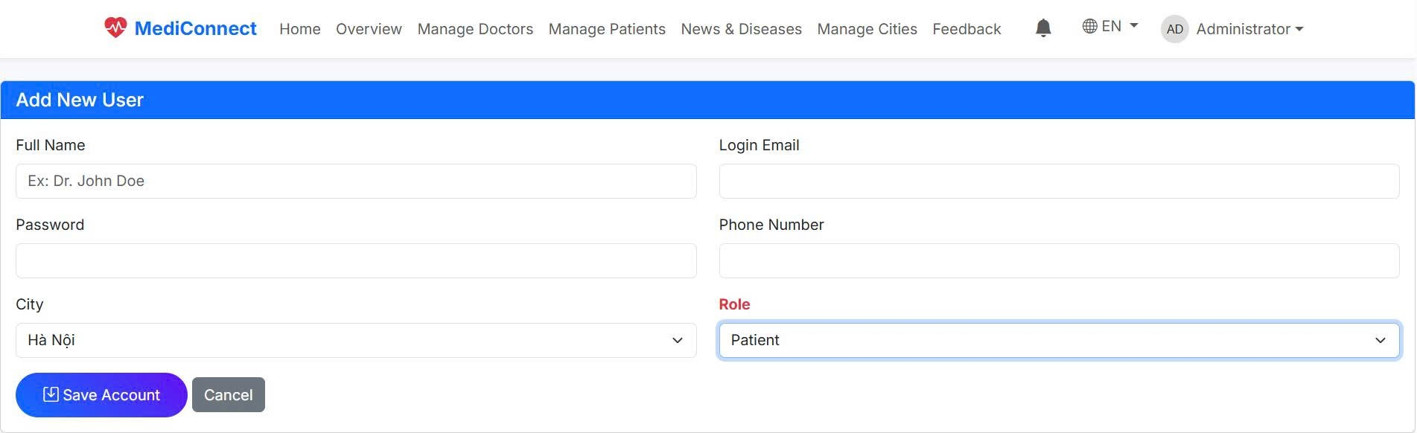
4.8. Add New User

Slide 32
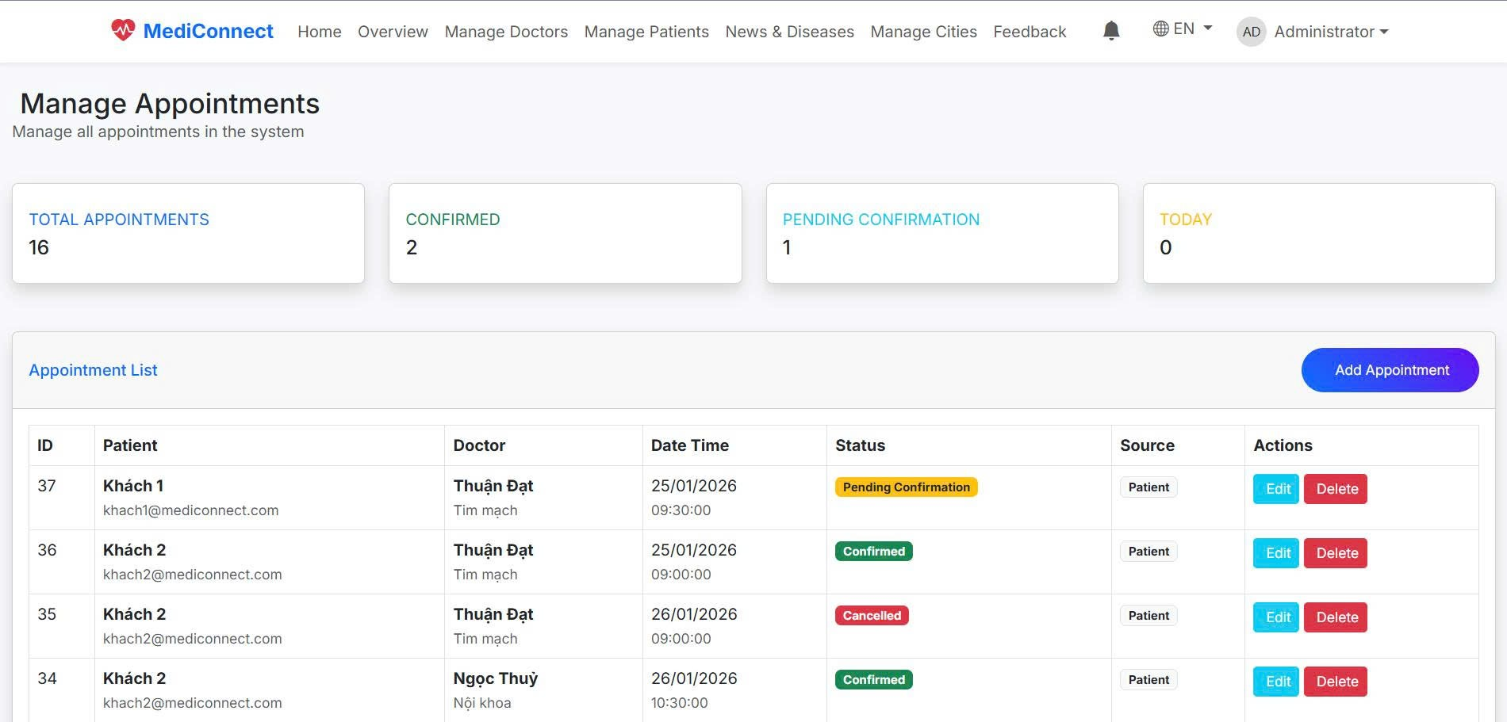
4.9. Appointment Management

Slide 33
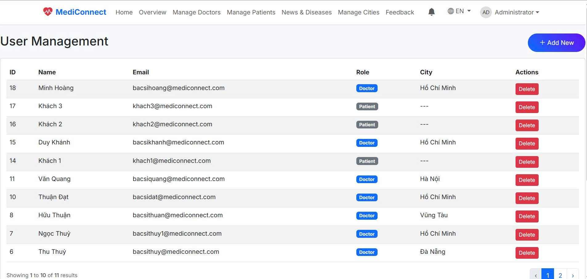
4.10. User Management

Slide 34
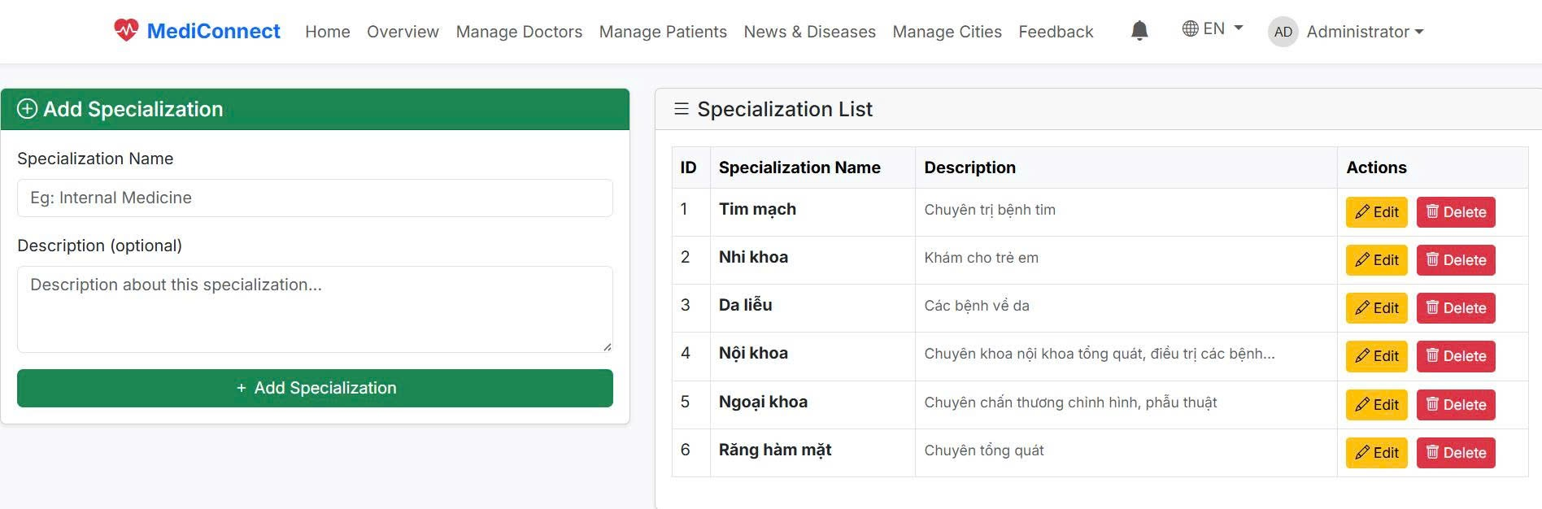
4.11. Specialization List

Slide 35
Task list
Name | Job | Participation(%)
Đào Nhuận Phát | Patient Feature (book appointment, feedback, update profile) | 100%
Mai Trọng Tín | Doctor Feature (manage schedule, approve appointment, update profile) | 100%
Huỳnh Thuận Đạt | Admin Feature (manage accounts/news/feedbacks/cities/specialists) | 100%
Lê Trọng Hoàng | Login and register, change password, homepage, layout, review 1+2+3, video demo | 100%

Slide 36


Thank
You

